Slide 1
Summary
Outliers
Feature selection
Model selection (accuracy based)
Results

Slide 2
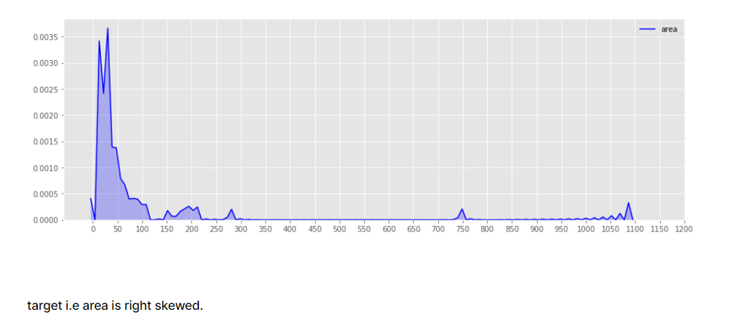
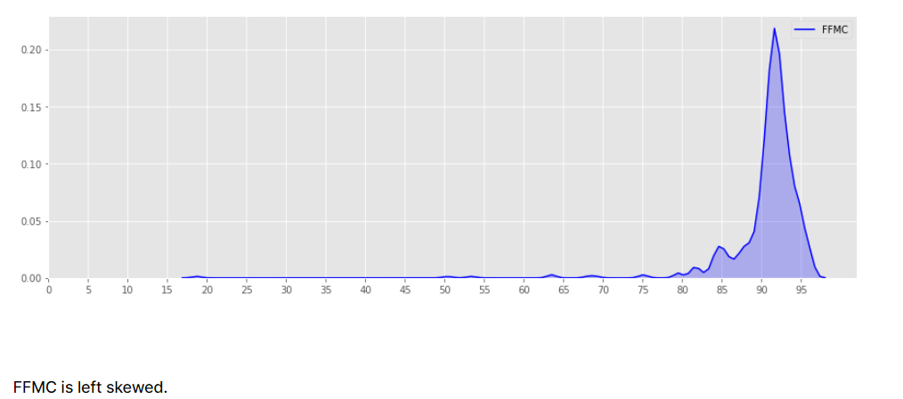
Outliers. Detecting outliers (e.g. Forest Fire [7])
If skewness = 0, the data are perfectly symmetrical. But a skewness of exactly zero is quite unlikely for real-world data, so how can you interpret the skewness number? Bulmer (1979) — a classic — suggests this rule of thumb:
If skewness is less than −1 or greater than +1, the distribution is highly skewed.
If skewness is between −1 and −½ or between +½ and +1, the distribution is moderately skewed.
If skewness is between −½ and +½, the distribution is approximately symmetric.
Feature columns:- 'FFMC', 'ISI', & 'rain', ‘area’ have higher kurtosis value. i,e have outliers.

Slide 3
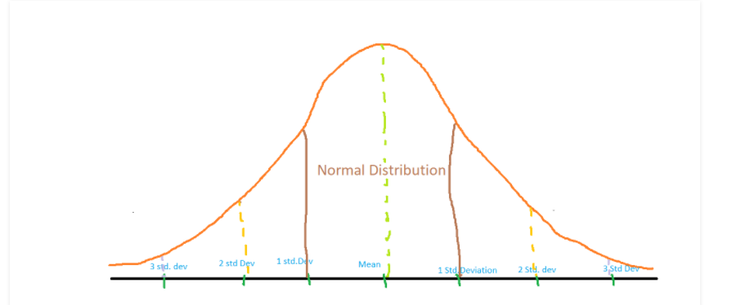
Outliers. Step1: Z-score method. see Appendix I
Z score is an important concept in statistics. Z score is also called standard score. This score helps to understand if a data value is greater or smaller than mean and how far away it is from the mean. More specifically, Z score tells how many standard deviations away a data point is from the mean.
Z score = (x -mean) / std. deviation
A normal distribution is shown below and it is estimated that
68% of the data points lie between +/- 1 standard deviation.
95% of the data points lie between +/- 2 standard deviation
99.7% of the data points lie between +/- 3 standard deviation
If the z score of a data point is more than 3, it indicates that the data point is quite different from the other data points. Such a data point can be an outlier. [4]

Slide 4
Outliers. Step2: Local Outlier Factor (LOF) [1]
The anomaly score of each sample is called Local Outlier Factor. It measures the local deviation of density of a given sample with respect to its neighbors.[1]
Advantage
A point will be considered as an outlier if it is at a small distance to the extremely dense cluster. The global approach may not consider that point as an outlier. But the LOF can effectively identify the local outliers.
Disadvantage
Since LOF is a ratio, it is tough to interpret. There is no specific threshold value above which a point is defined as an outlier. The identification of an outlier is dependent on the problem and the user. [2]
Fortunately Sklearn marks inliers with 1, outliers with -1. [1]
But user should decide what % of data to remove?

Slide 5
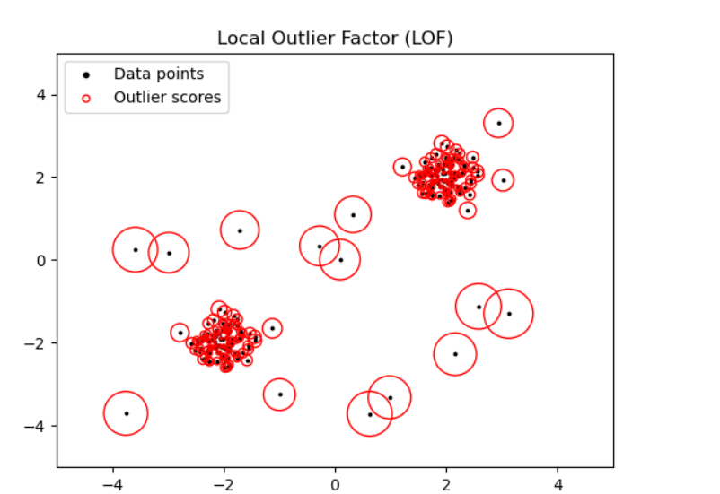
Outliers. Step2: Local Outlier Factor
The number of neighbors considered (parameter n_neighbors) is typically set 1) greater than the minimum number of samples a cluster has to contain, so that other samples can be local outliers relative to this cluster, and 2) smaller than the maximum number of close by samples that can potentially be local outliers. In practice, such informations are generally not available, and taking n_neighbors=20 appears to work well in general. [6]

Slide 6
Outliers. Step2: Local Outlier Factor (e.g. Forest Fire [7])
see Appendix II
n_neighbors | N of data | % of data | MLP | MT
517 | 517 | 100% | 4090.528 | 5489.0
490 | 502 | ~95% | 151.897 | 163.93
390 | 354 | ~75% | 8.506 | 8.34
260 | 191 | ~50% | 0.059 | 0.033
130 | 273 | ~25% | 6.473 | 7.25
50 | 408 | ~10% | 12.589 | 14.63
25 | 467 | ~ 5% | 104.660 | 119.78

Slide 7
Feature selection. Variance inflation factor (VIF)
For i in [0, #features-1] run Ordinary Least Squares (OLS) method with i^{th} feature and rest
Calculate r2 score, ranges in [0, 1]
VIF = 1/(1-r2 score), ranges in [1,inf)
r2_score represents the proportion of variance (of y) that has been explained by the independent variables in the model. It provides an indication of goodness of fit and therefore a measure of how well unseen samples are likely to be predicted by the model, through the proportion of explained variance. [1]
r2 | 0 | 0.1 | 0.2 | 0.3 | 0.4 | 0.8 | 0.9 | 0.999 | 1
VIF | 1 | 1.1 | 1.25 | 1.42 | 1.66 | 5 | 10 | 1000 | inf

Slide 8
Feature selection. VIF threshold see Appendix III
R2_score >= 0.8, highly correlated (VIF >= 5) [1] page 147.
VIF >= 5 or 10 indicate problematic amount of collinearity [2] page 101.
VIF >= 2.5 considerable collinearity [3].
VIF >= 10 means collinearity [4] and considered as a rule of thumb [5]
Strategy: drop single feature with highest VIF > 10 at a time, repeat until no feature with VIF > 10 is left.

Slide 9
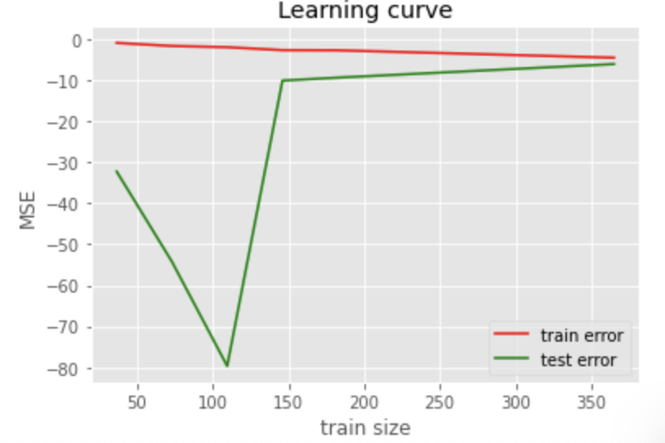
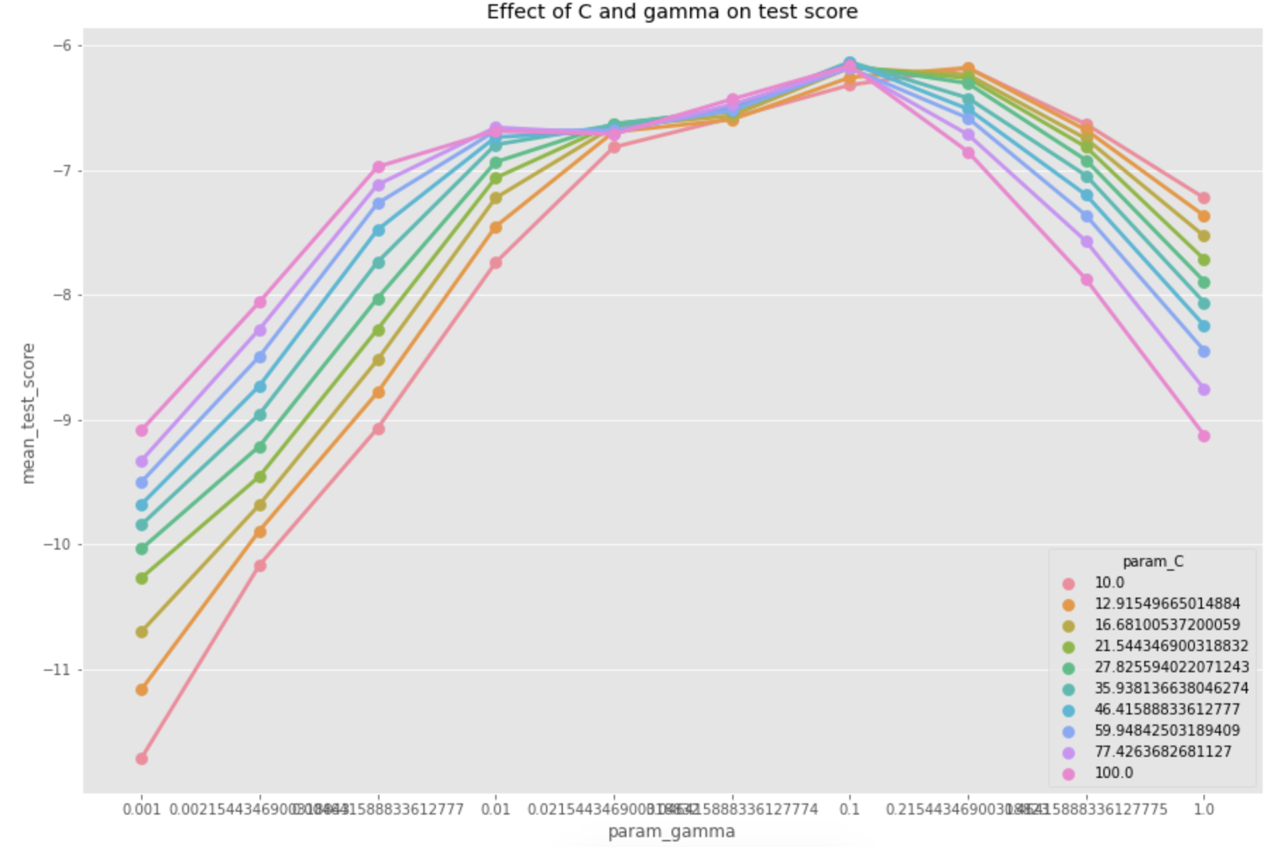
Model selection. SVR (C, gamma, degree) (e.g. with Auto MPG [8]) see Appendix IV
General strategy:
pick an arbitrary range of hyper-parameters for GirdSearchCV, shift hyper-parameters toward low error side iteratively
Use best parameters in NuSVR to test with different limits on number of support vectors
Make sure model does not overfit/underfit and best hyper-parameters lie in the middle of given range
Large values of gamma and C tend to overfit.
'C':np.logspace(1,2,10), gamma:np.logspace(-3,0,10). MSE: 6.129
Best Hyperparameters: {'C': 35.938136638046274, 'gamma': 0.1, 'kernel': 'rbf'}
Range for degree is limited to [1,2] or [2,3] since training times for other values are too long.
Figure1. Learning curve
Figure2. Searching best parameters

Slide 10
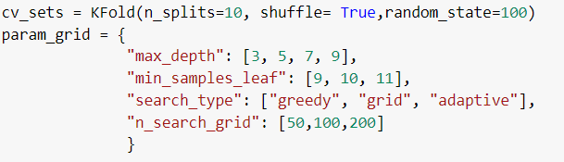
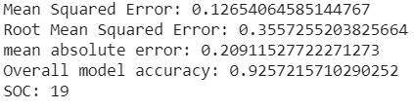
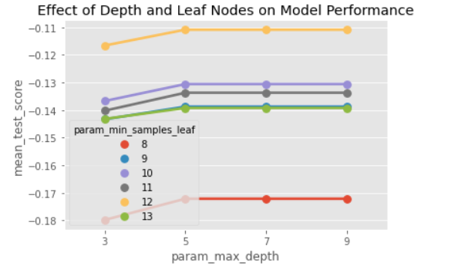
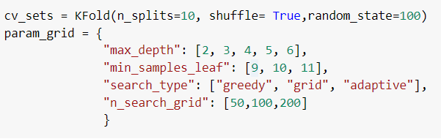
Model selection. MT
Step 1. Parameter tuning, searching for best max_depth parameter

Slide 11
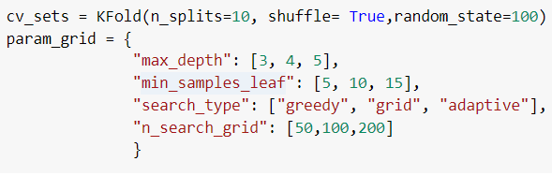
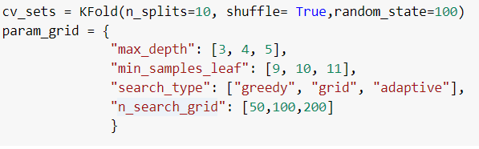
Model selection. MT
Step 2. Searching best value for parameter min_samples_leaf

Slide 12
Model selection. MLP
Step 1. Searching for the suitable network ( default hidden_layer_size = (100,) )
'activation': ['logistic', 'tanh', 'relu'], 'hidden_layer_sizes': [(100,), (100, 100), (100, 100, 100), (100, 100, 100, 100), (100, 100, 100, 100, 100)], 'learning_rate_init': np.logspace(-4,-2, 10)
Best : 'activation': 'relu', 'hidden_layer_sizes': (100, 100, 100, 100), 'learning_rate_init': 0.01
Mse : 12.29140932778277
Step 2. Shifting range depending on best parameter found in prev. Step
'hidden_layer_sizes': [(1,1,1,1), (10,10,10,10), (100, 100, 100, 100), (200,200,200,200)], 'learning_rate_init': np.logspace(-4,-2, 10)
Best : 'hidden_layer_sizes': (100, 100, 100, 100), 'learning_rate_init': 0.00046415888336127773
Mse : 8.178435941033133
Step 3. Repetition. Shifting range depending on best parameter found in prev. Step
'hidden_layer_sizes': [(150,150,150,150), (100, 100, 100, 100), (50,50,50,50)], 'learning_rate_init': np.logspace(-4,-2, 10)
Best : 'hidden_layer_sizes': (100, 100, 100, 100), 'learning_rate_init': 0.002154434690031882
Mse : 6.611754837102716
Step 4. Repetition. Shifting range depending on best parameter found in prev. Step
'hidden_layer_sizes': [(75,750,75,75), (125,125,125,125), (100, 100, 100, 100)], 'learning_rate_init': np.logspace(-4,-2, 10)
Best : 'hidden_layer_sizes': (75, 750, 75, 75), 'learning_rate_init': 0.003593813663804626
Mse : 4.782631562000682

Slide 13
Results
Cell format: Mean Squared Error & Mean Absolute Error
Datasets Models | Servo(easy) | Auto MPG(medium) | Forest Fire(hard)
MLP | 0.020 & 0.084 | 6.903 & 1.954 | 109.158 & 6.503
MT | 0.146 & 0.205 | 7.75 & 1.99 | 140.46 & 7.43
SVR | 0.131 & 0.227 | 6.24 & 1.82 | 104.38 & 5.147
References (MSE & MAE) | 0.800 & 0.220 | 3.730 & 2.020 | 16.400 & 6.334

Slide 14
Appendix I. Applying z-score on datasets
Results\ Dataset | Servo | Auto MPG | Forest Fire
Number of instances removed | 2 out of 167 | 13 out of 398 | 31 out of 517
Effect on final MSE (MLP, MT, SVR) %
 | 0.125 0.453 -72.4% | 0
 | 7.71 8.72 -11.58% | +2.6
 | 5489 137.5 -97.5% | -10

Slide 15
Appendix II. Local Outlier Factor
Results\ Dataset | Servo | Auto MPG | Forest Fire
Number of instances removed | 13 out of 165 | 20 out of 387 | 18 out of 486
Effect on final MSE (MLP, MT, SVR) %
 |  | +13
 |  | -13
 |  | -78

Slide 16
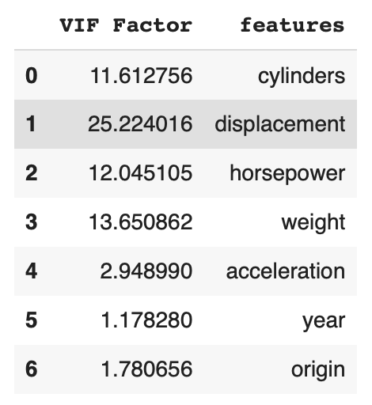
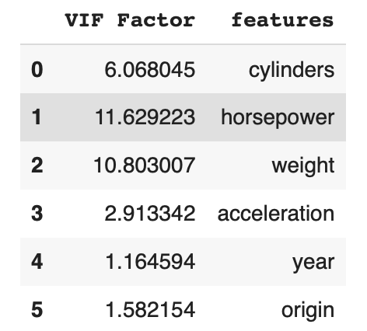
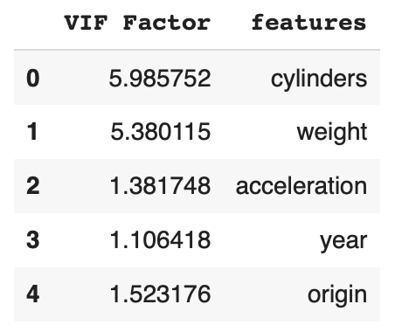
Appendix III. Collinearity is observed only in Auto MPG:
With all features
With displacement removed
With horsepower removed

Slide 17
Appendix III. Effect of reducing number of features on Auto MPG
 | MLP | MT | SVR
On MSE |  |  | +1.17%
On SOC |  |  | -26%

Slide 18
Appendix IV. SVR model selection

